Slide 1
Submitted by :-
Abhinav Nandrajog
(2010990019) abhinav0019.be20@chitkara.edu.in
Front End Development Project
To:-
Mr.Lavish Arora

Slide 2
Project 1
Creators’ ਅੱਡਾ
LINK :- https://github.com/abhinavnandrajog/Project-Creator-

Slide 3


About Us
This page tells you about the reason behind the formation of this website and about me.

Slide 4
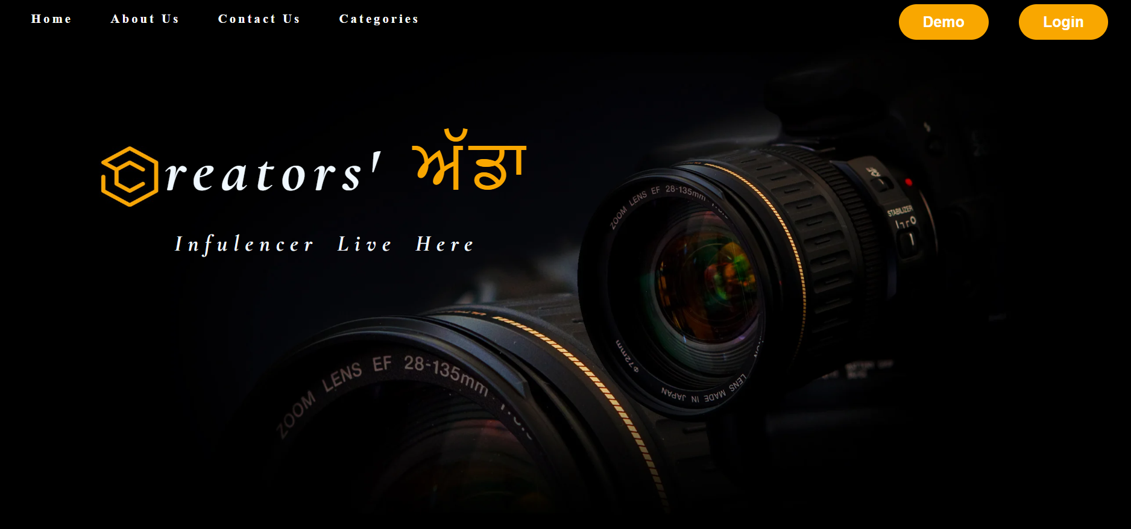
Home Page
It is the Main page of the website, containing links to the other sections of the website like About Us,Contact Us,Demo page and Login/Sign Up.

Slide 5

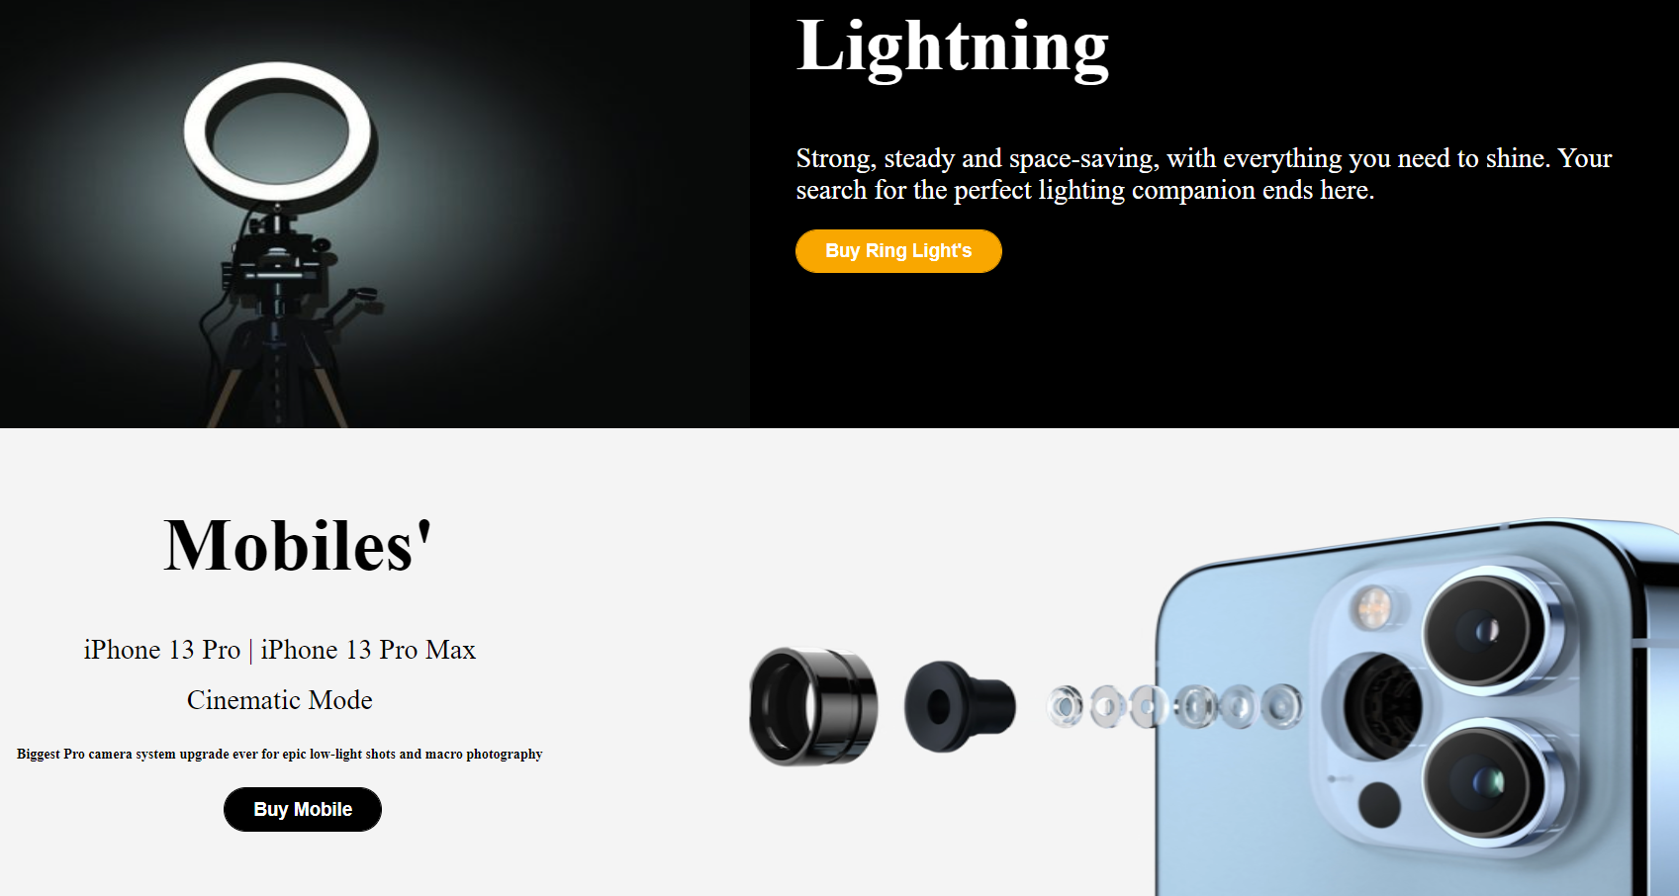
Multiple Sections in Home page giving an overview of the famous products.

Slide 6

At the end of Home page, we have name of our few global partners and we have our footer section containing all the important information.

Slide 7
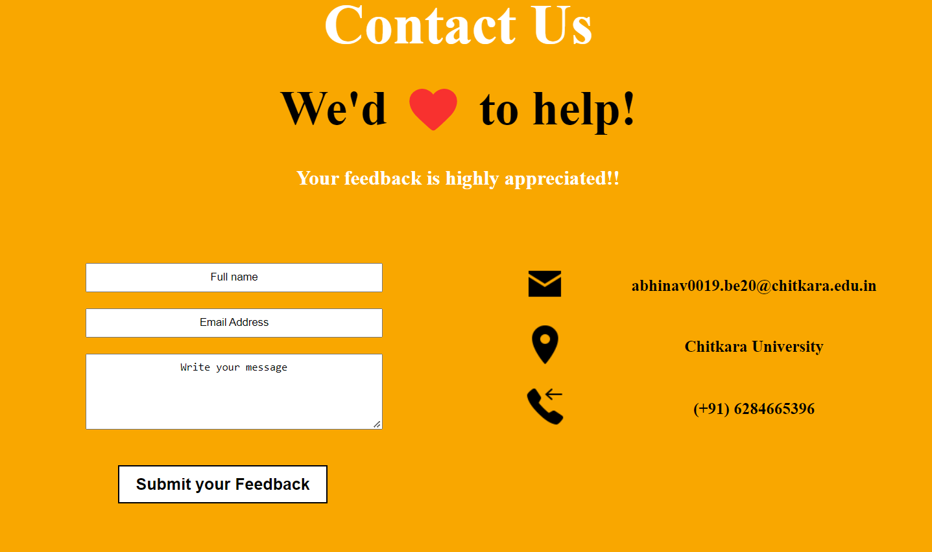
Contact us:-
It is the Feedback form where people can contact us for any queries and can also give their reviews.

Slide 8
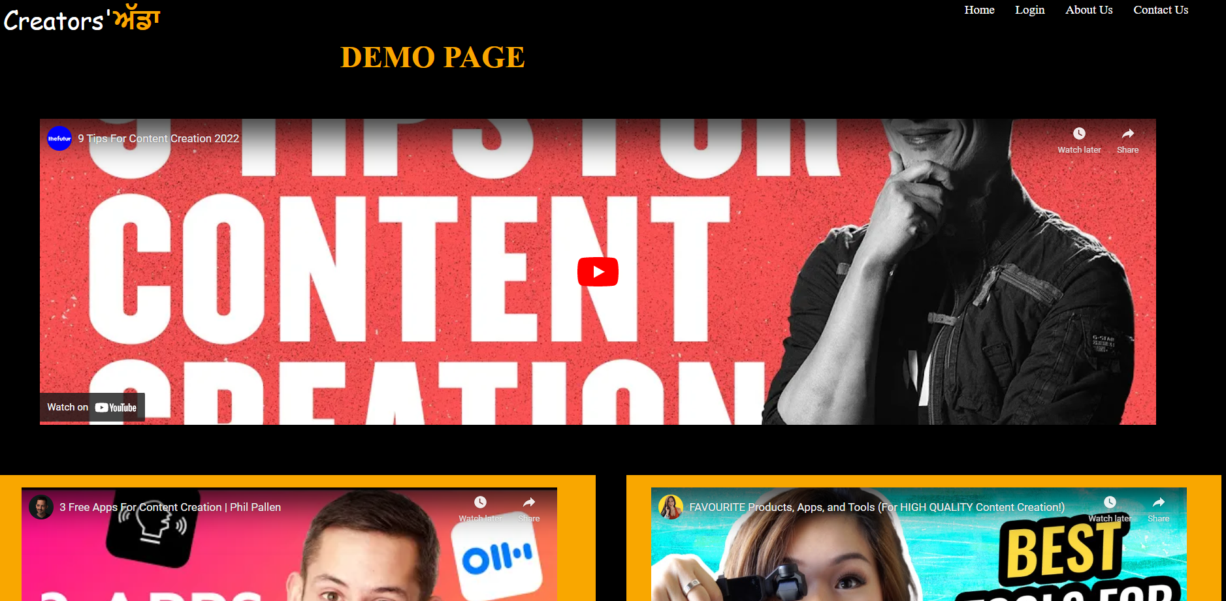
Demo Page :-
Demo page contains link to different youtube videos giving a demo of the products being used.

Slide 9
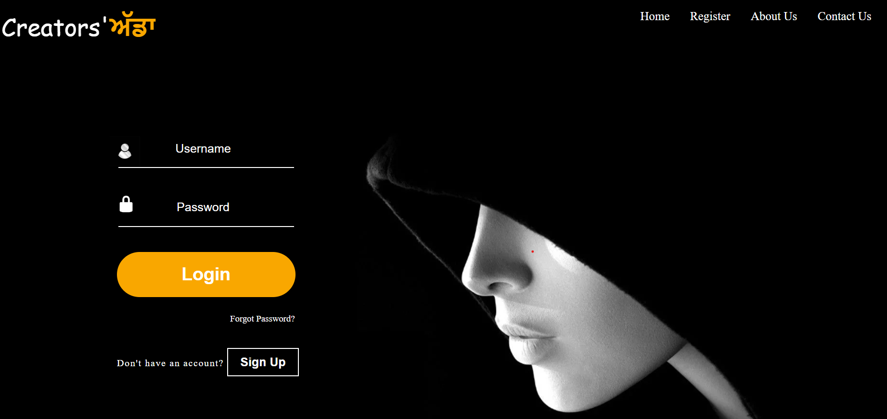
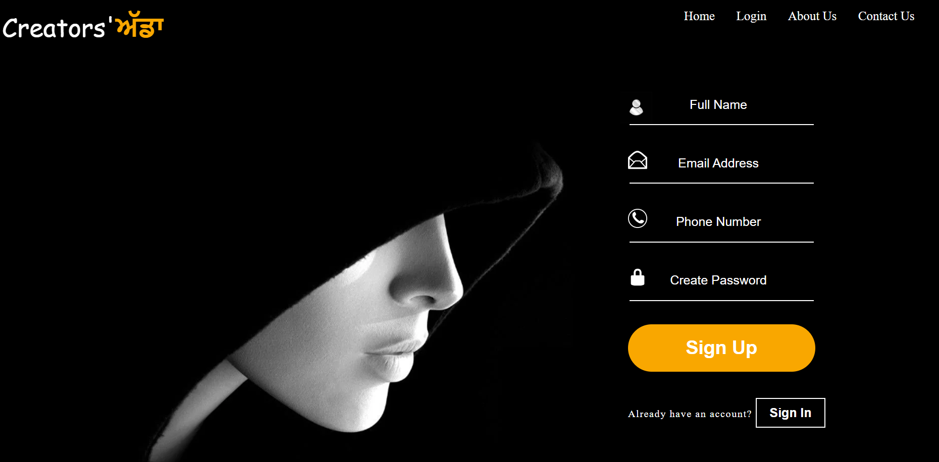
Login/SignUp page:-
Login Page
Sign Up Page

Slide 10

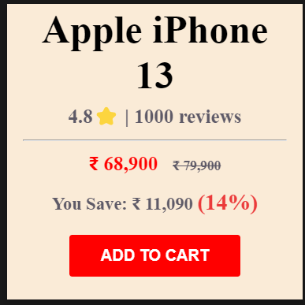
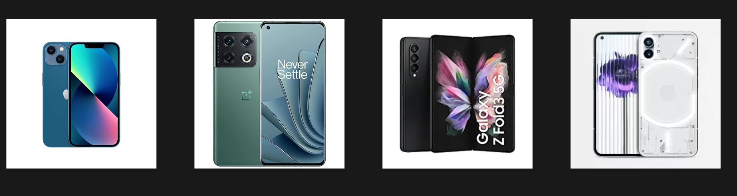
ST-2
Categories Page:-
Created a new Categories page, added a carousel and different items which flip when hover and there is pop up when you click on add to cart.

Slide 11
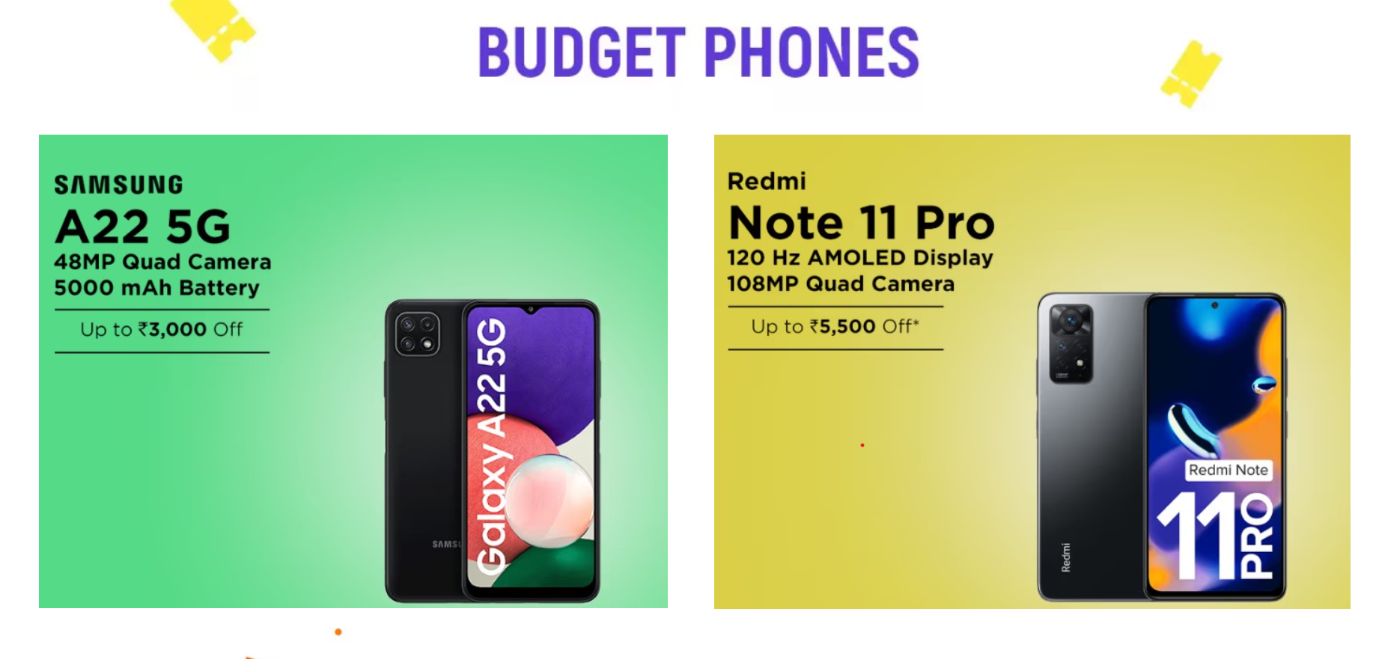
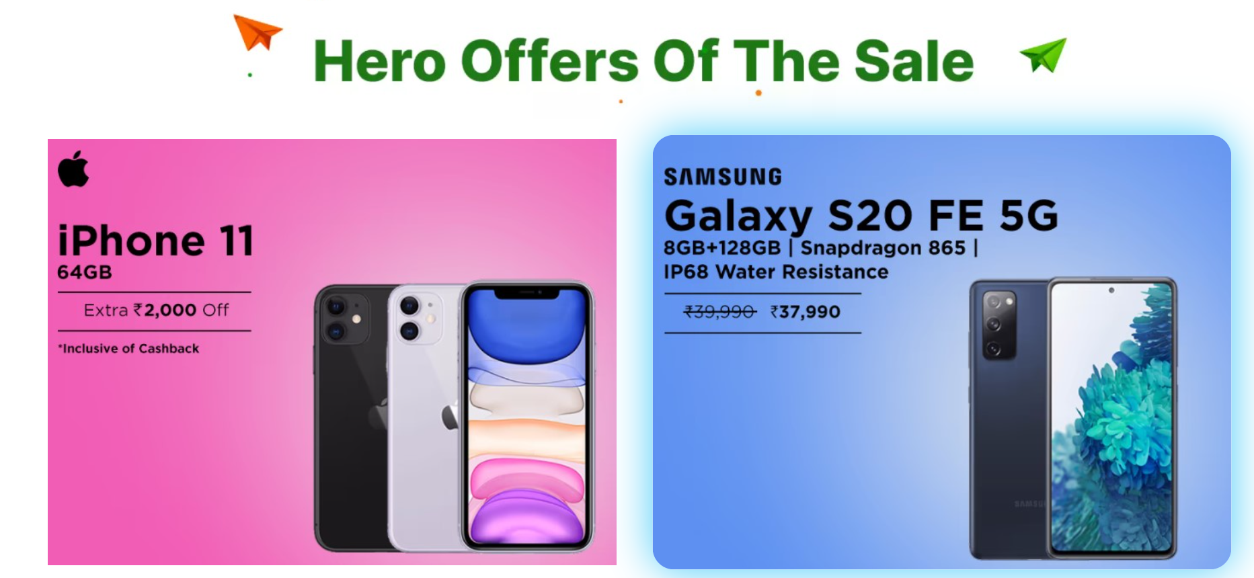
Different sections our created for variety of phones.

Slide 12
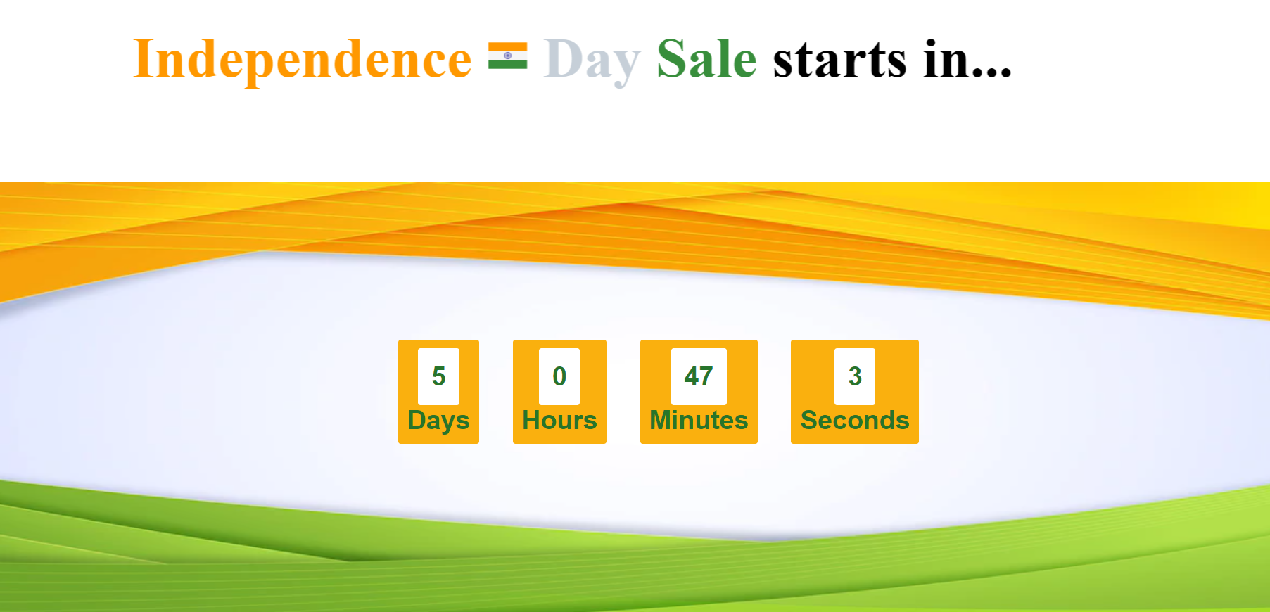
Added a Timer at home page telling us about the sales

Slide 13
Project 2
Food ਅੱਡਾ
LINK :- https://github.com/abhinavnandrajog/Food

Slide 14
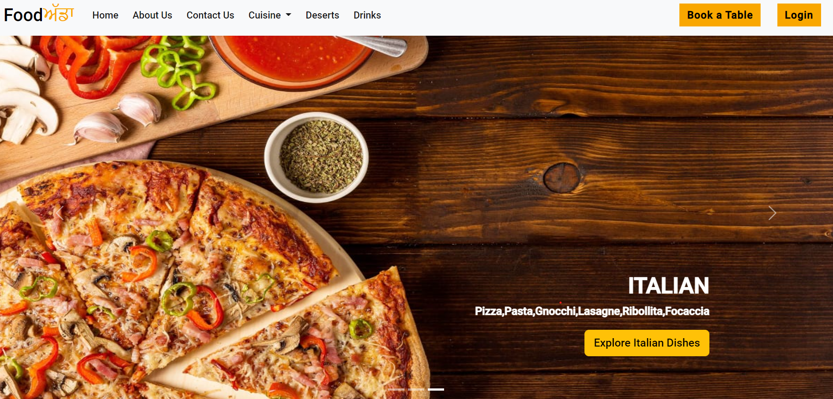
Home Page
It includes a carousel with the help of bootstrap

Slide 15
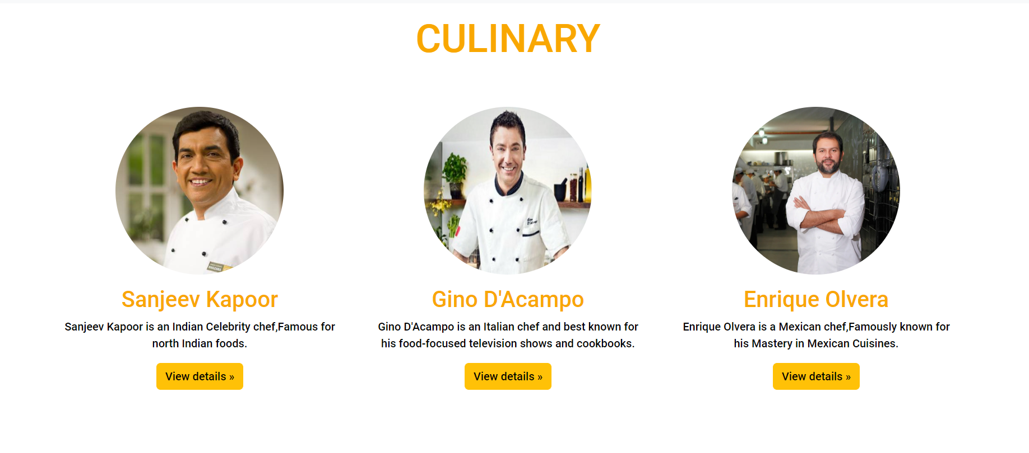
Our Chef’s:-

Slide 16
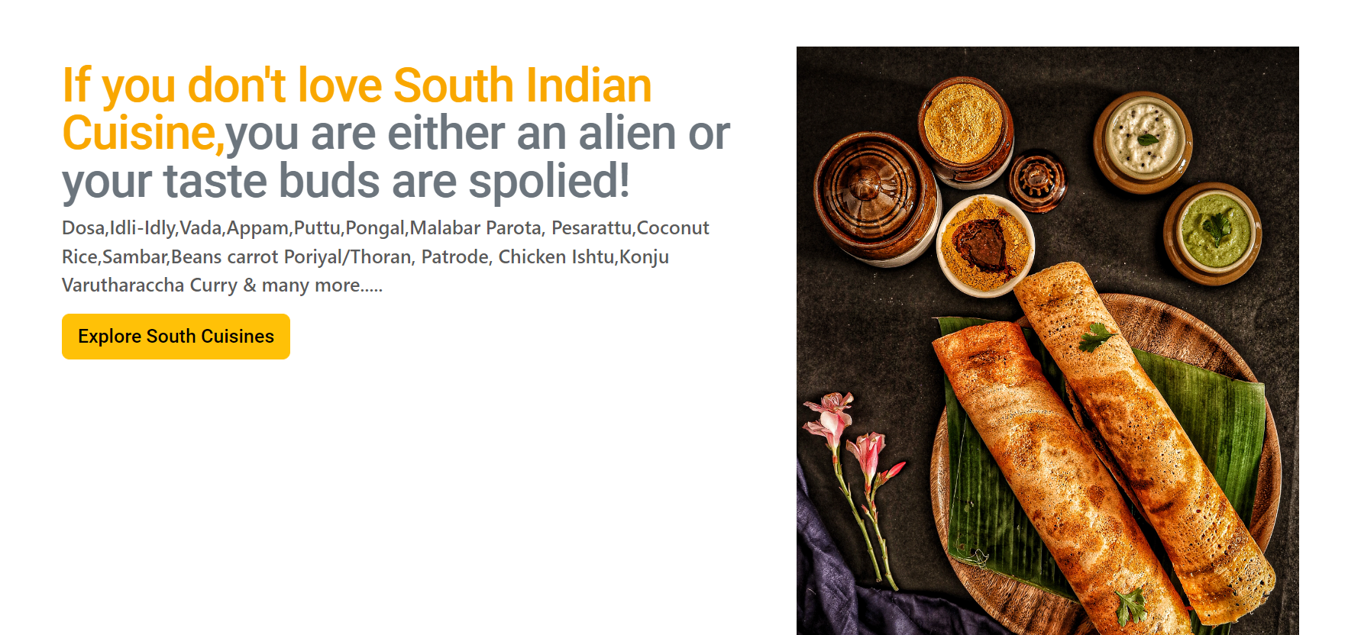
Explore Different dishes

Slide 17
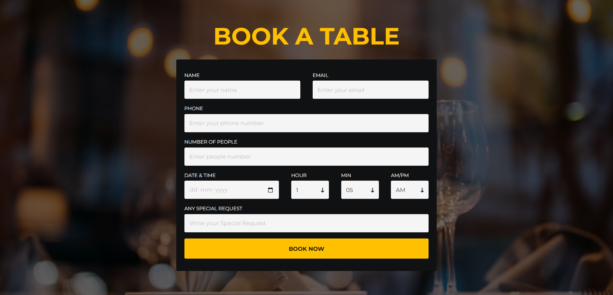
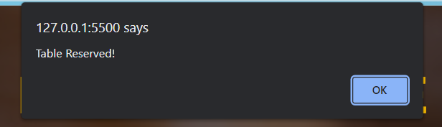
Book a Table
Pop up comes when you click on Book now

Slide 18
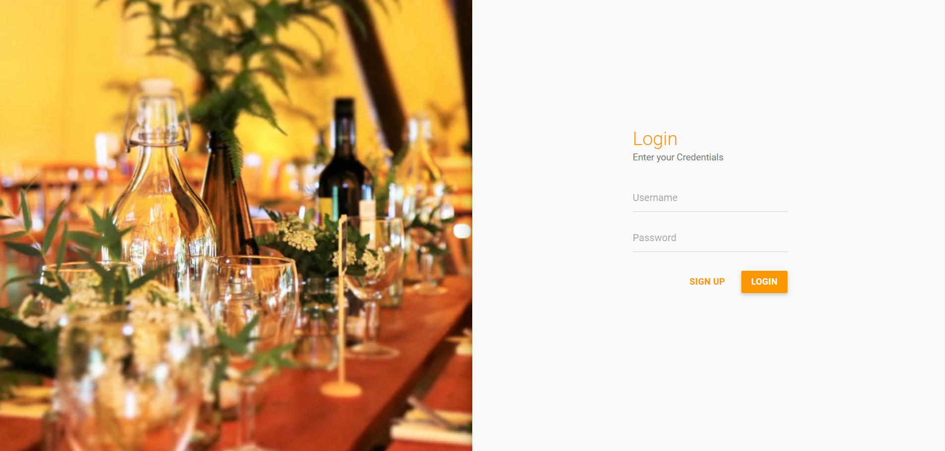
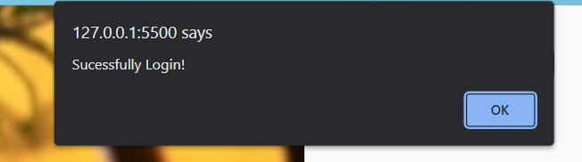
Login Page
Pop up on successfully login and redirects you to home page.

Slide 19
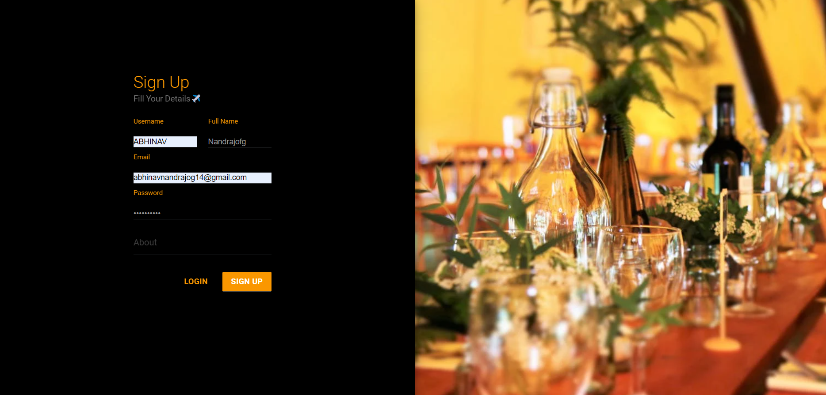
Sign up Page

Slide 20
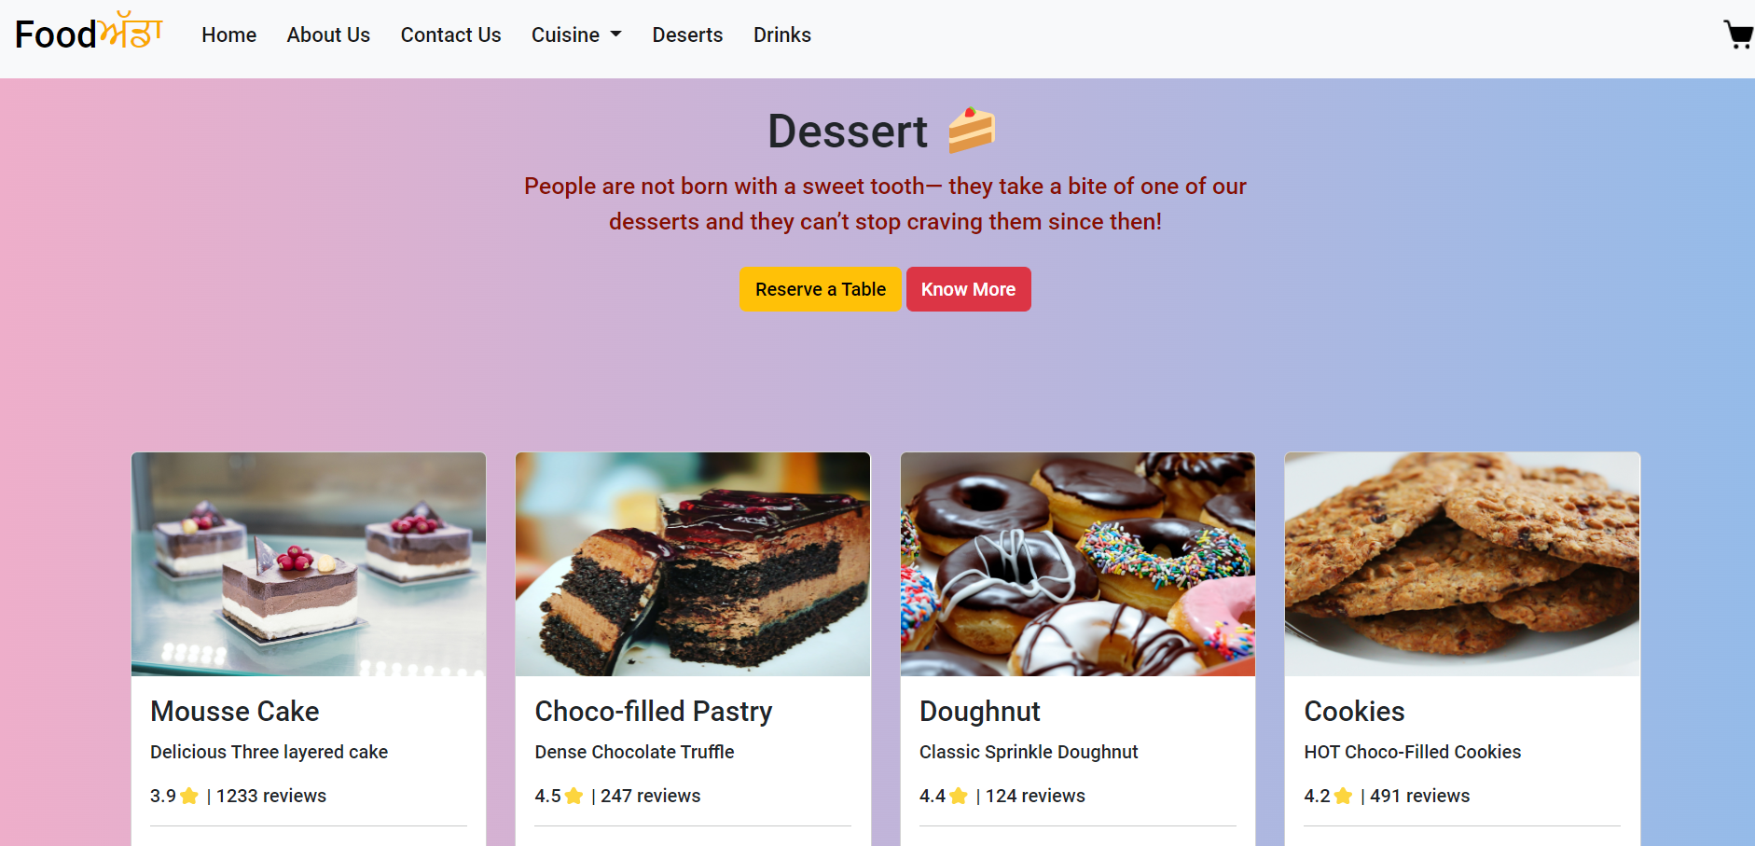
Desserts

Slide 21
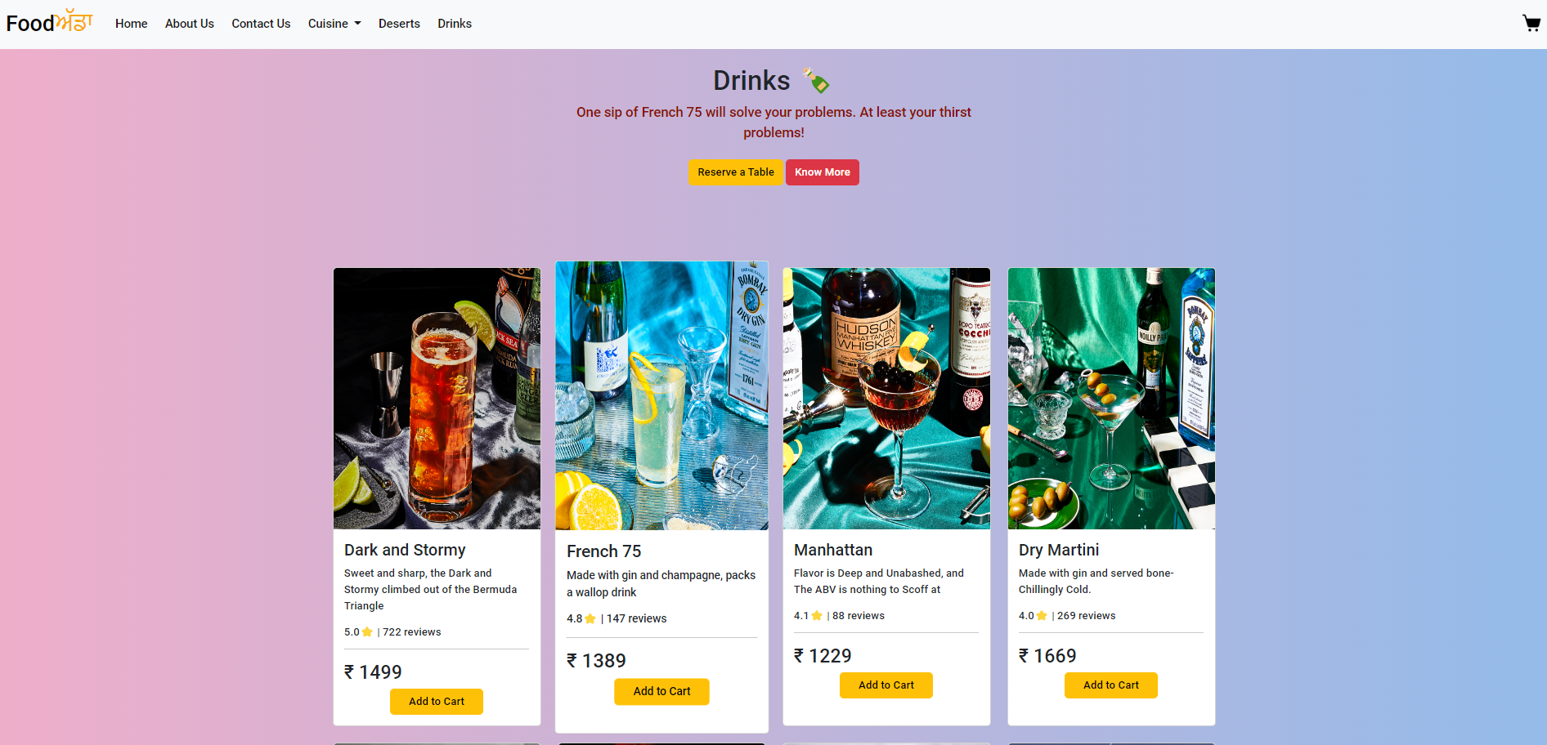
Drinks

Slide 22
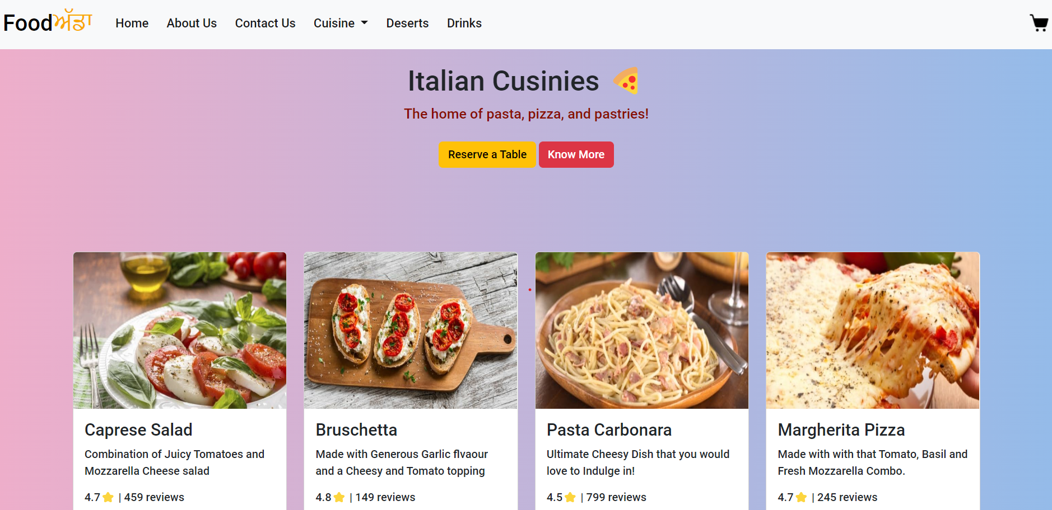
Italian Cusinies

Slide 23
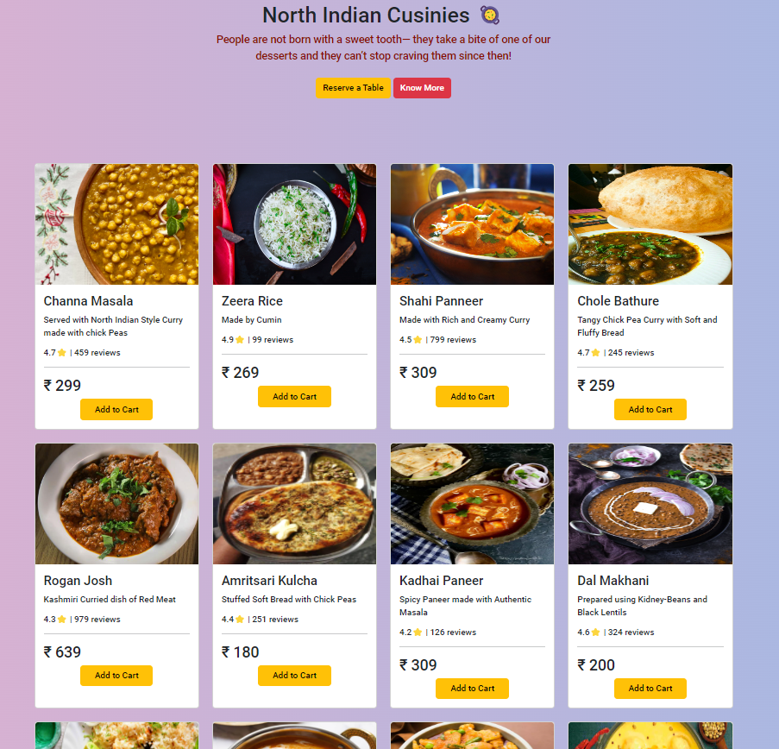
North Cuisines

Slide 24
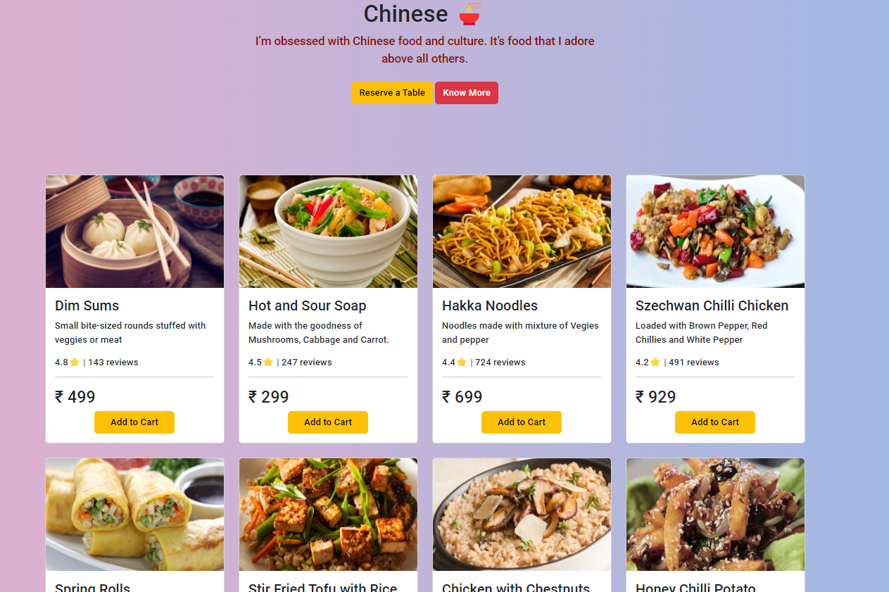
Chinese Cuisines

Slide 25
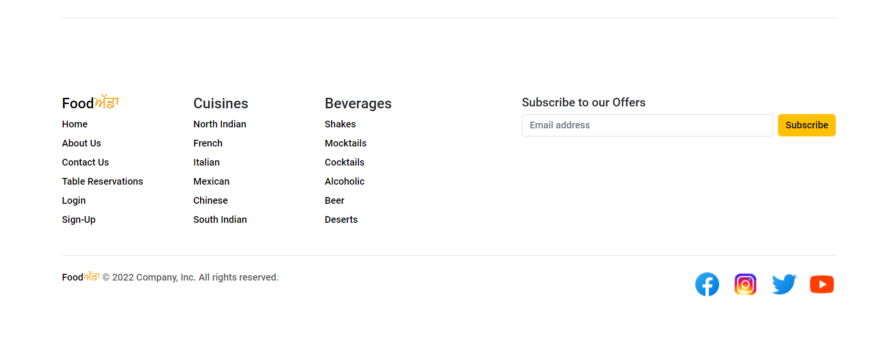
Footer Section

Slide 26
HTML Tags used in Project:-
<br>
<a>
<textarea>
<img>
<input>
<a>
<iframe>
<section>
<hr>
<span>
<div>
<h1,h2,......,h6>
<button>
<form>
<p>

Slide 27
CSS properties used in Project:-
padding
margin
Height
Width
Position:absolute;
Position:relative;
Float:left;
Float:right;
Border
Background-color;
Flex
clear
Hover
Font-weight
Font-size
Font-family
Text-decoration
Transition
Line-height
Letter-spacing
Word-spacing
Underline

Slide 28
JavaScript used in Project:-
Added a timer using JS in Home Page
Form validation added in the login form
If username and password matches the database it will redirect you to categories page.
Using windows. Alert() , popup is there anytime you login,signIn or submit a feedback form.
A box appears on the center of page if we add items to the cart

Slide 29
JavaScript used in Project:-
window.alert()
onclick()
onmouseover()
onmouseout()
window.open()
manual functions

Slide 30
Bootstrap used in Project:-
container
fluid
alert
bg-color
nav
cards
col
carousel

Slide 31
Thank You

